Slide 1
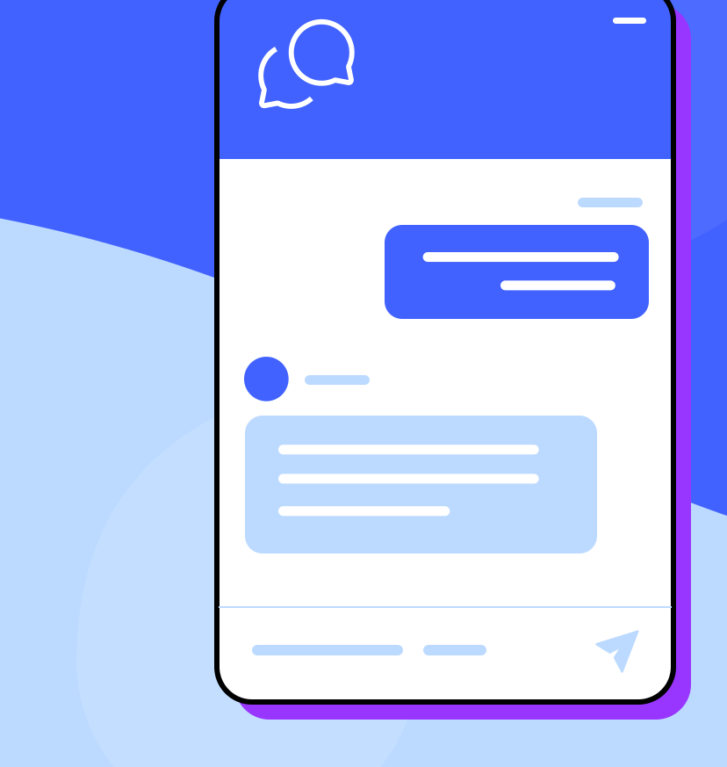

Secure
Java Socket
Chat Server
  Clean • Modern • Colorful • AI-enabled
By: Dany, Karvens, & Alex

Slide 2
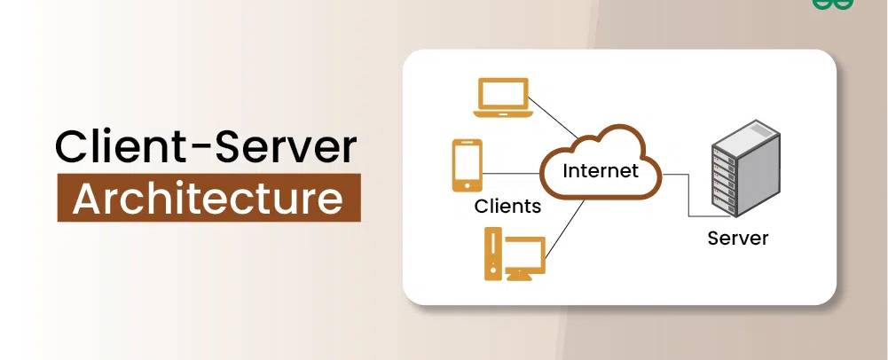
This is a secure client‑server chat system built in Java
Uses TCP sockets for communication
Implements encryption and authentication
Includes optional AI‑powered chatbot responses
Authentication & Admin controls
AI integration via /askgpt
Full logging + history buffer
Project Overview

Slide 3
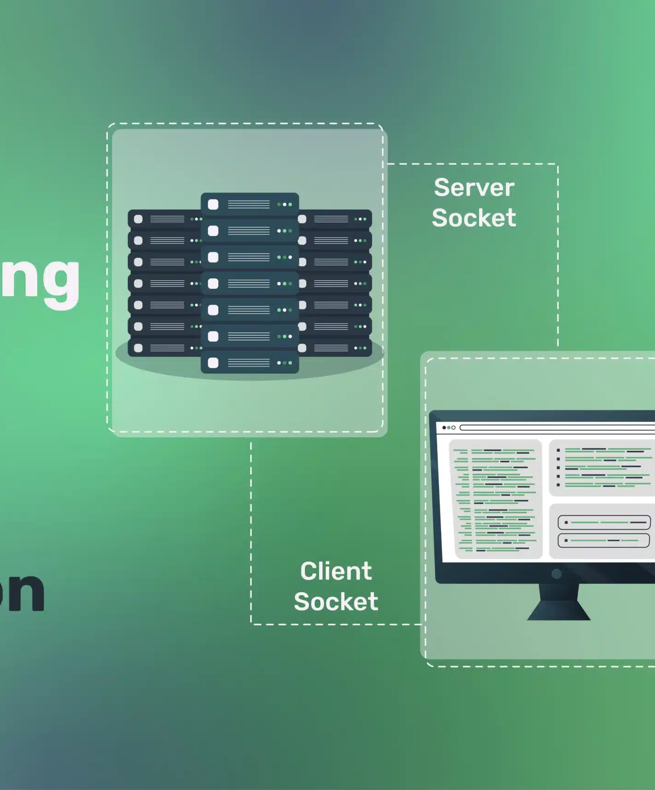
Project Objectives
Learn Java networking (TCP Sockets)
Build a secure communication channel
Enable multiple clients to chat in real‑time
Integrate optional generative‑AI assistant
Improve system reliability and error handling

Slide 4
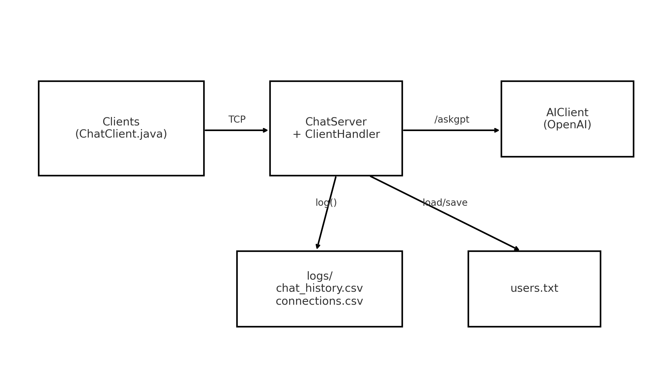
System Architecture
Clients (ChatClient.java)
Connect to server via TCP
Send/receive chat messages + /askgpt
ChatServer + ClientHandler
Authenticates users
Routes broadcast + private messages
Handles admin commands
Writes logs and updates users.txt
Spawns one thread per client
AIClient (OpenAI)
Processes /askgpt requests
Returns AI responses to the server
Data Storage
users.txt → account storage
logs/chat_history.csv → message logs
logs/connections.csv → login/admin logs
Flow
Clients ↔ Server ↔ Logs / users.txt
Clients ↔ Server ↔ AI (for /askgpt)

Slide 5

Client components
Java socket client connecting to server
Supports user login, signup, messaging, commands
Sends JSON/text protocol messages
Receives broadcast, private messages, system alerts
Command shortcuts: /pm, /typing, /askgpt, /list
Fully compatible with future GUI front-ends

Slide 6

Server components
Manages all client connections via ServerSocket
Spawns a ClientHandler thread per user
Maintains online user list and message routing
Enforces authentication + admin privileges
Handles AI requests asynchronously
Maintains history buffer (last 1000 messages)

Slide 7

Authentication System
Uses users.txt for account storage
Passwords stored using SHA-256 hashing
Supports signup, login, password change
Auto-creates default admin if none exists
Logs: LOGIN_SUCCESS / LOGIN_FAIL / SIGNUP_SUCCESS
Legacy plaintext upgraded automatically

Slide 8
Admin Controls
/kick <user> — forcibly disconnect user
/changepw <user> — reset account password
/rename <old> <new> — rename active user
/announce <msg> — global system message
/exit-server — shutdown server safely
All actions logged with timestamps & IP

Slide 9
Communication protocol
Text-based commands/messages
Broadcast: username: message
Private: /pm <user> <message>
Typing indicator: /typing and
/stoppedtyping
AI request: /askgpt <question>
Admin commands: /kick, /rename, /changepw, /announce
Messages tagged & logged by type

Slide 10

AI Intergration
Command: /askgpt <question>
Server forwards request to AIClient
AIClient calls OpenAI API asynchronously
Response returned only to requesting client
Perfect for: coding help, summaries, Q&A
Fully optional feature (non-blocking)

Slide 11
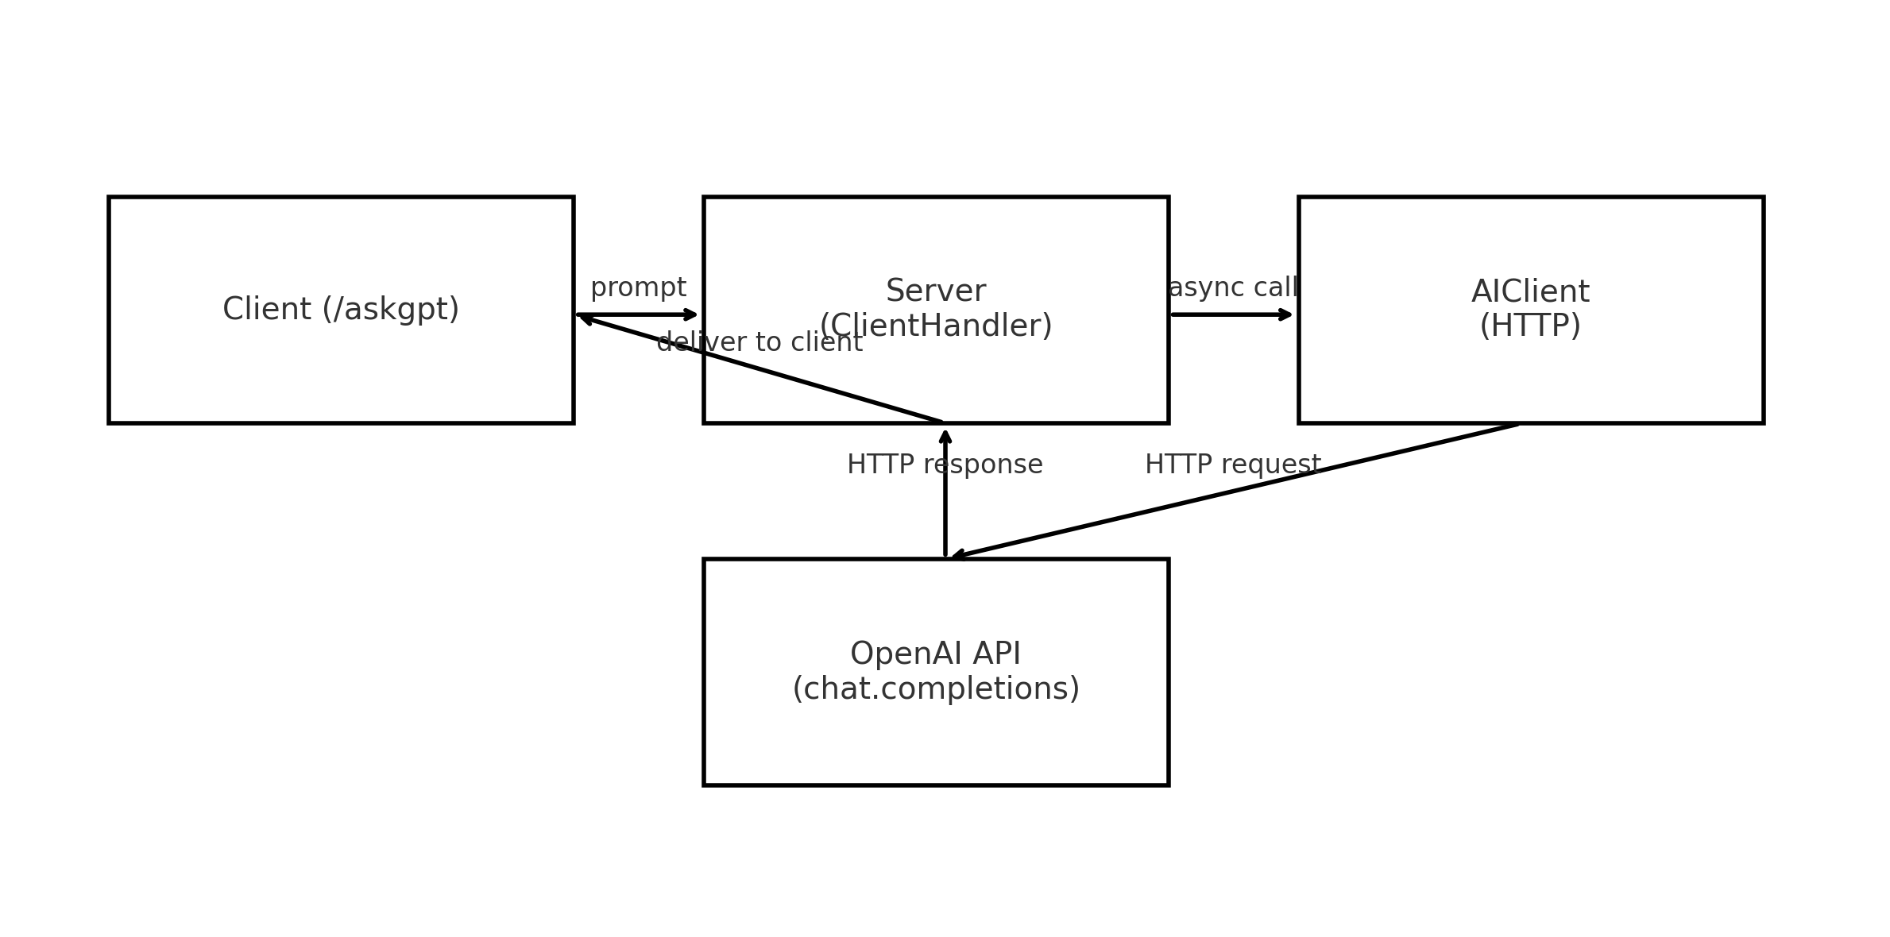
AI Integration / AI Request Flow

Slide 12
Error Handling
Try/catch handling for all socket operations
Heartbeat & disconnect detection
Auto-cleanup on crashes or unexpected exits
Input validation for all commands
Graceful server shutdown procedure
Logs track all errors for debugging

Slide 13
How to Run the system
Compile all Java files
Set OPENAI_API_KEY in environment
Start server: java ChatServer 12345
Clients connect using:java ChatClient localhost 12345
Login or signup
Start chatting or try commands like:
/pm user Hello!
/askgpt Why is Java good for networking?
/list

Slide 14

Chat Features:
Messaging System
Real-time broadcast chat
Private messages using /pm
System announcements for joins/leaves
Auto-formatted messages for readability
AI messages returned privately
Admin messages labeled distinctly
Simple and intuitive for any user.

Slide 15
Multi-Threading & Concurrency
Multi-Threading & Concurrency
The system uses:
One thread per active client
Synchronized access to shared data
Thread pool for AI requests
Clean shutdown signals for all threads
Benefits:
No blocking between users
Smooth performance
Scales well for many clients

Slide 16
Data Structures Used
Txt.files
HashMap<String, ClientHandler> — online users
HashMap<String, User> — stored accounts
ArrayList<String> — history buffer
ExecutorService — async AI tasks
CSV logs — persistent storage
Each structure was selected for speed, memory efficiency, and thread safety.

Slide 17

Chat Features:
Typing Indicators
The server supports real-time typing status:
/typing while user is typing
/stoppedtyping when idle
Broadcast to all active users
Automatically reset when user sends a message or disconnects
Adds a modern chat-like interaction experience.

Slide 18
Chat Features: History Buffer
When a user logs in, they receive:
“=== Last 1000 Messages ===”
This includes:
Broadcast chat
System announcements
Admin messages
AI responses (if desired)
Never miss important conversation context
— similar to joining a Discord channel and seeing recent chat history.

Slide 19
Chat Features:
Join/Leave Announcements
"Bob joined (Online: 5)"
  "Alice left (Online: 4)"
  Logged + included in history buffer

Slide 20
Admin Features: Powerful Tools
/kick, /changepw, /rename, /announce, /exit-server
  Instant effects (kick/rename apply to live sessions)
All admin actions logged
Rename flow: /rename old new → live map updated → broadcast
  Kick flow: notify → log → disconnect → system message
  Announce: [ADMIN] <message>

Slide 21
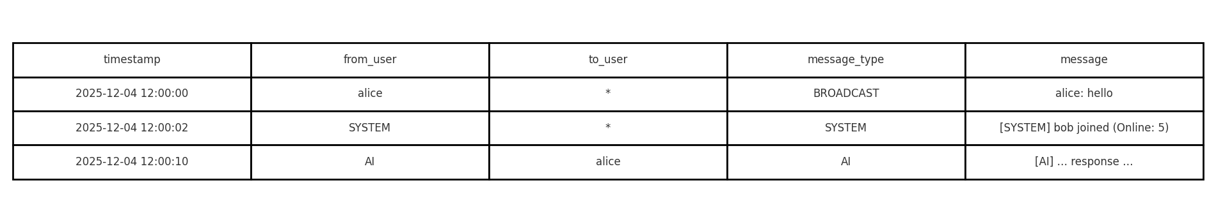
Admin Logging & Auditing
Two logs store all activity:
connections.csv
CONNECT / DISCONNECT
LOGIN_SUCCESS / LOGIN_FAIL
SIGNUP_SUCCESS
ADMIN_ACTION
SERVER_SHUTDOWN
chat_history.csv​
BROADCAST​
PRIVATE​
SYSTEM​
ADMIN​
AI_RESPONSE​
Logs contain timestamps, usernames, andmessage metadata.​
​

Slide 22
Server Console Menu
Start server
Stop server
change port
View connections
show log paths
Reload users.txt
exit application

Slide 23
Logging System
Two CSV files track activity:
connections.csv
  Logins, disconnects, admin actions, timestamps
chat_history.csv
  Messages, private chats, AI replies, errors, events
  History Buffer:
  The server stores the last 1000 messages in memory and
  sends them to users upon login so they can catch up instantly.

Slide 24
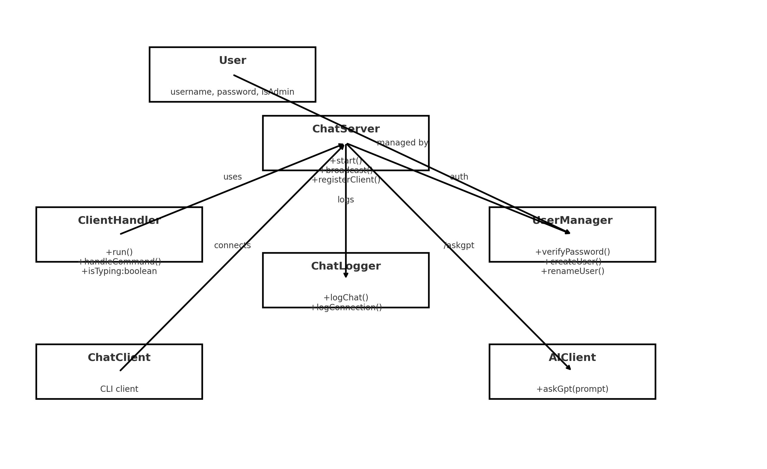
UML: Class Diagram
Core classes:
ChatServer, ClientHandler, UserManager, ChatLogger, AIClient, ChatClient, User
  Key relations: Server ↔ ClientHandler; Server ↔ UserManager; Server ↔ ChatLogger; Server ↔ AIClient

Slide 25
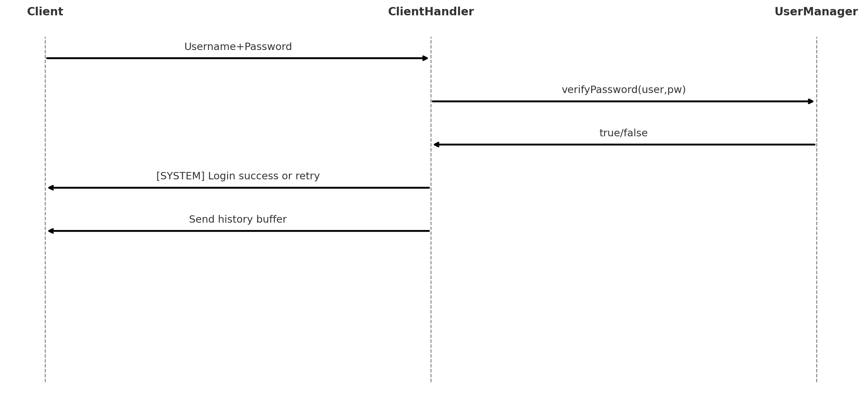
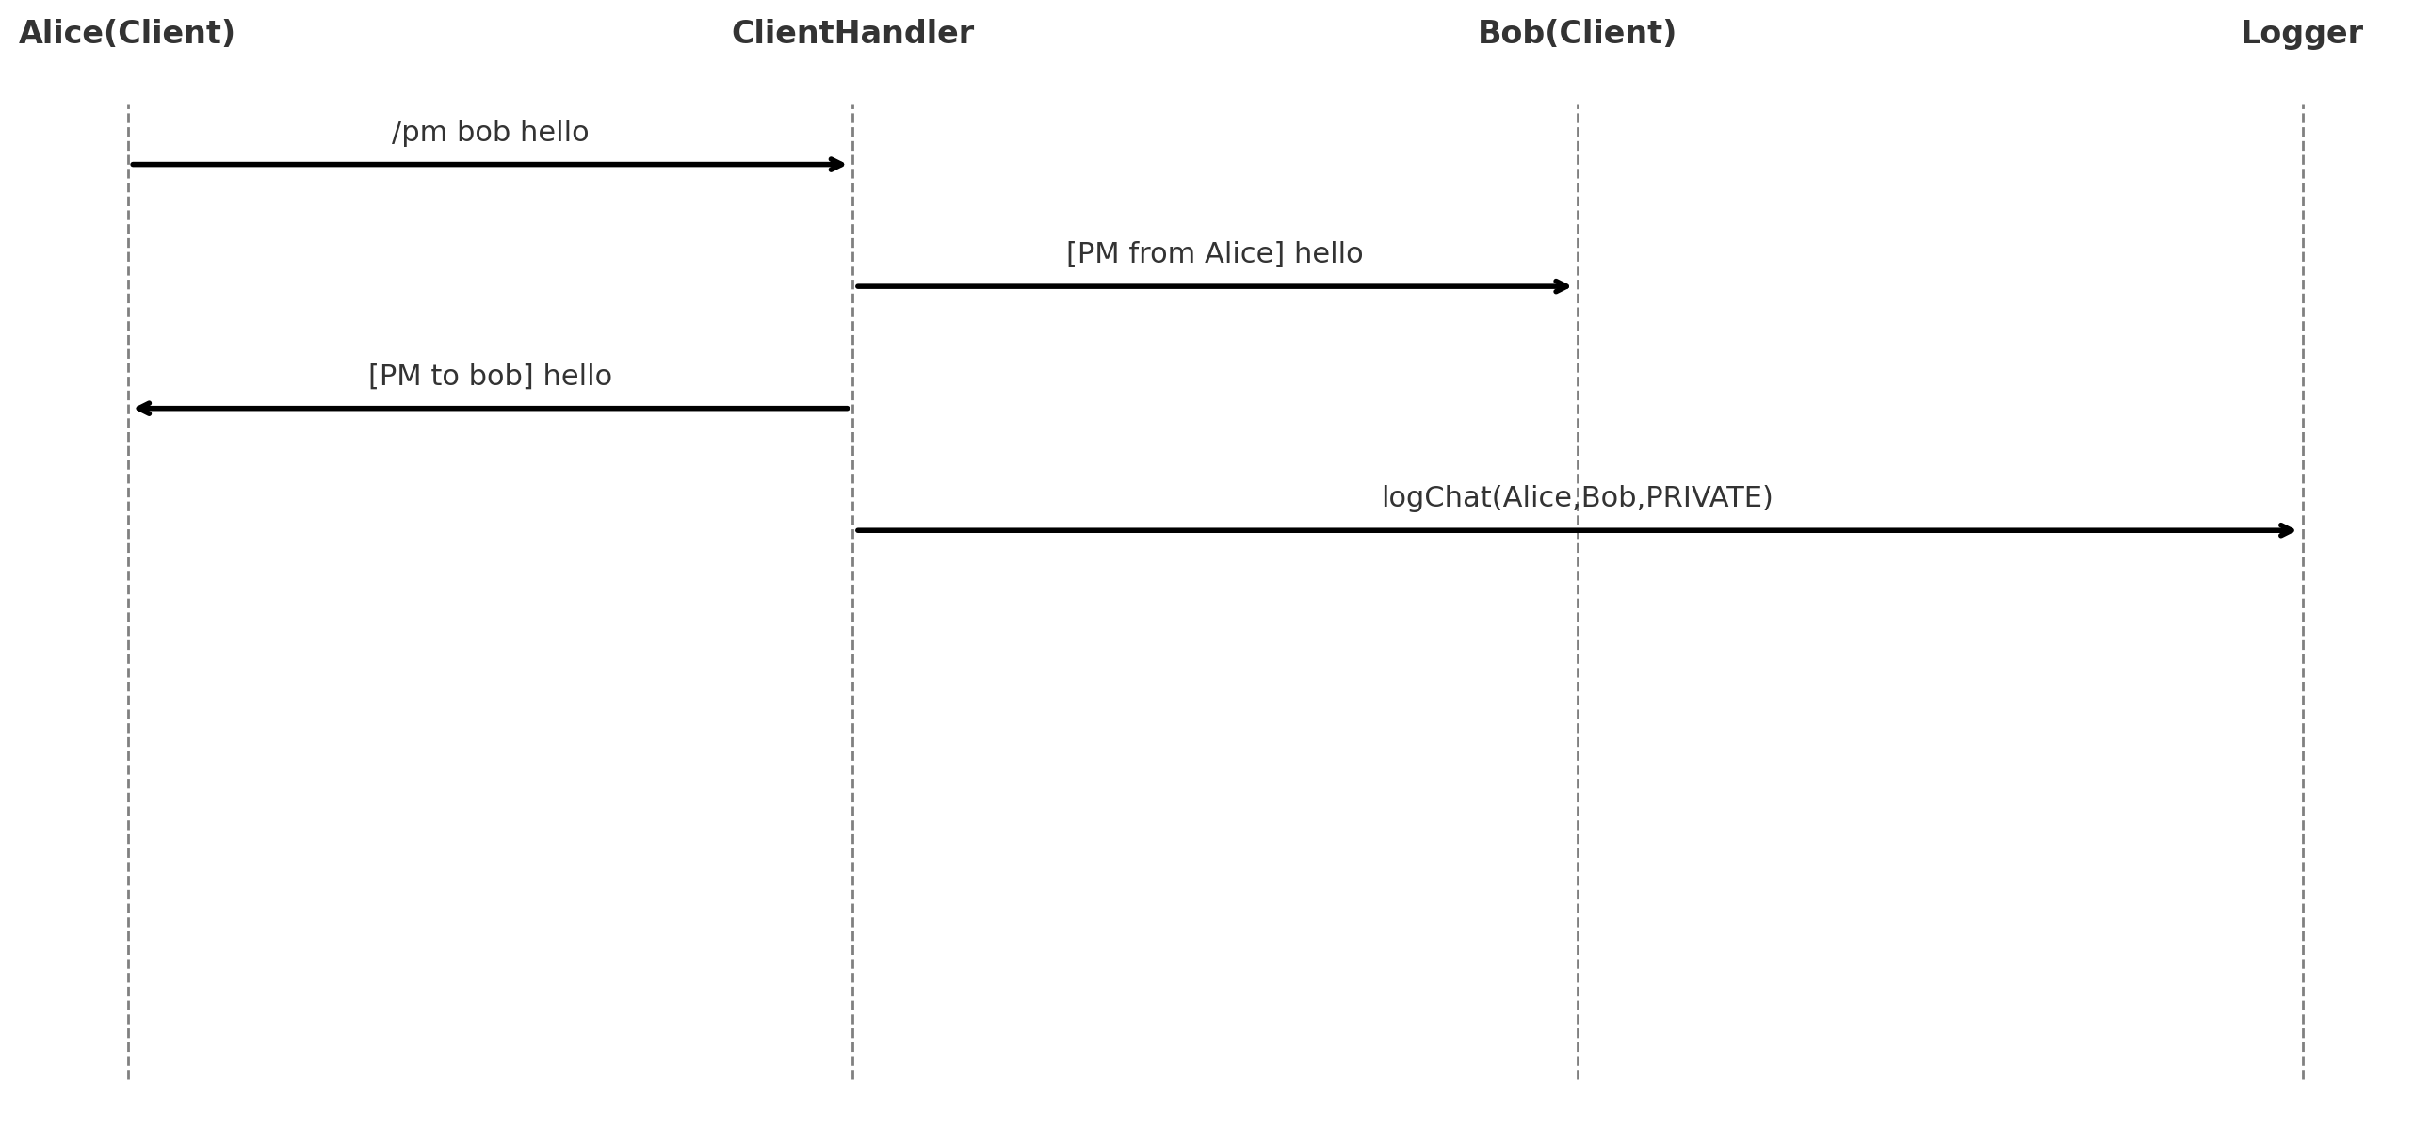
UML: Sequence Diagrams
(Login & PM)

Slide 26

Future improvements
&
conclusion
✅ Conclusion
Built a fully functional Secure Multi-User Java Socket Chat Server
Supports real-time messaging, authentication, admin tools, logging
Includes /askgpt AI integration for enhanced communication
Demonstrates strong skills in Java networking, concurrency, security, and system design
Provides a scalable foundation for a professional messaging platform
🚀 Future Improvements
Add SSL/TLS encryption for full end-to-end security
Build a JavaFX/Swing GUI client
Implement file transfer and rich media support
Migrate users/logs to a database backend
Deploy to the cloud for real-world availability
Add rate limiting & spam detection
Build GUI interface

